Slide 1
Statistics Web Sites
© McGraw Hill LLC. All rights reserved. No reproduction or distribution without the prior written consent of McGraw Hill LLC.

Slide 2
General Resources
American Statistical Association (what is statistics?)
https://www.amstat.org/asa/what-is-statistics.aspx
Journal of Statistics Education (articles and datasets)
https://www.amstat.org/publications/jse/
Chance (articles and datasets)
https://www.amstat.org/publications/chance/

Slide 3


Statistical Ethics
American Statistical Association
Ethical Guidelines for Statistical Practice
https://www.amstat.org/ASA/Your-Career/Ethical-Guidelines-for-Statistical-Practice.aspx
These ASA guidelines encourage ethical and effective statistical work in morally conducive working environments. They also assist students in learning to perform statistical work responsibly and improve public understanding and respect for statistics throughout its range of applications..

Slide 4


CAUSE
Consortium for the Advancement of Undergraduate Statistics Education
https://www.causeweb.org
This web site collects, reviews, develops, and disseminates resources under the active guidance of over 40 professionals at dozens of institutions. It offers animations, case studies, drills, quizzes, lectures, simulations, tutorials, and data sets.

Slide 5


Women in Statistics
Consortium for the Advancement of Undergraduate Statistics Education
https://cwstat.org/
“Our mission is to advance the careers of women statisticians through advocacy, providing resources and learning opportunities, increasing their professional participation and visibility, and promoting and assessing research that impacts women statisticians.”

Slide 6
R and RStudio
https://www.r-project.org/
https://rstudio.com/products/rstudio/
R is a free software environment for statistical computing and graphics. It runs on UNIX ,Windows, and MacOS. The R Foundation is a not for profit organization. RStudio is an integrated development environment (IDE) for R. It includes a console, an editor that supports direct code execution, and tools for plotting, history, debugging and workspace management. RStudio is available in open source and commercial editions.

Slide 7
Free Software
John C. Pezzullo's Home Page
https://statpages.info/javasta2.html
This web site offers links to algorithms and statistical software, much of it free. The web site author was formerly Associate Professor in the Departments of Pharmacology and Biostatistics at Georgetown University, in Washington, DC.

Slide 8
Free Resources
Open Intro
https://www.openintro.org/
Learning Statistics With R (Danielle Navarro)
https://learningstatisticswithr.com/
Open College Books
http://www.opencollegebooks.org/

Slide 9
Data Sets
Dennis Roberts, Penn State Univ (Minitab data sets)
https://www.personal.psu.edu/users/d/m/dmr/minitab/mtbtutor.htm
Statistical reference data Sets (for software testing)
https://catalog.data.gov/dataset/nist-statistical-reference-datasets-srd-140
Data sets and story library (basic statistics)
https://dasl.datadescription.com/

Slide 10
Data Sets
Duke University
https://stat.duke.edu/resources/datasets
SOCR – Univ of S. California
http://www.socr.ucla.edu/SOCR.html
Arnold Neumaier - Universität Wien
https://www.mat.univie.ac.at/~neum/statdat.html

Slide 11

Big Data Sets
Free Big Data Repository Links
https://www.datasciencecentral.com/profiles/blogs/a-plethora-of-data-set-repositories

Slide 12
Government Data I
Bureau of Economic Analysis www.bea.gov
Bureau of Justice Statistics www.bjs.gov
Bureau of Labor Statistics www.bls.gov
Central Intelligence Agency www.cia.gov
Economic Report of President www.gpo.gov/erp
Environmental Protection Agency www.epa.gov
Federal Reserve System www.federalreserve.gov

Slide 13
Government Data II
Agricultural Statistics www.nass.usda.gov
Education Statistics www.nces.ed.gov
Food/Drug Admin www.fda.gov
Health Statistics www.cdc.gov/nchs
Internal Revenue Service www.irs.gov/statistics
Transportation www.bts.gov
U.S. Census Bureau www.census.gov
U.S. Federal Statistics www.usa.gov/statistics

Slide 14
Other Data Sources
Org for Econ Dev www.oecd.org
Statistics Canada www.statcan.gc.ca
USA Facts https://usafacts.org
U.N. Econ/Social Affairs www.un.org/depts/unsd
World Bank www.worldbank.org
World Demographics www.demographia.com
World Health Organization www.who.int/en
Worldometers www.worldometers.info

Slide 15
Fun Sites - I
Claremont Graduate University
https://wise1.cgu.edu/applets.asp
Process Capability
https://elsmar.com/Cp_vs_Cpk.html

Slide 16
Fun Sites - II
KDNuggets
https://www.kdnuggets.com/
Newton Gresham Library – Sam Houston State University
https://shsulibraryguides.org/stats

Slide 17
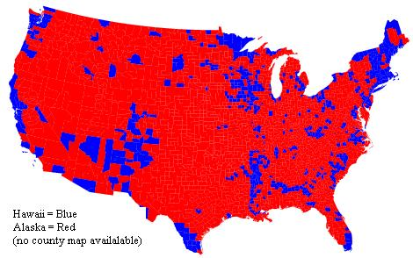

Graphs
American Statistical Association
What's Going On in This Graph
https://www.amstat.org/ASA/Whats-Going-on-in-this-Graph.aspx
What's Going On in This Graph is a free, online weekly feature from The New York Times Learning Network and the American Statistical Association.

Slide 18
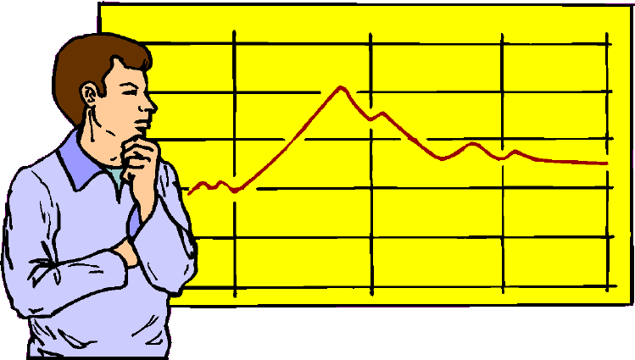
Data Science
Statistics is a key component of the field of business intelligence, which includes technologies for collecting, storing, accessing, and analyzing data in order to make better business decisions. Wikipedia defines data-mining as the analysis of large quantities of data to extract previously unknown patterns, unusual cases, and dependencies. This involves using database techniques and powerful statistical tools. The growing field of data science has engendered competitions and $$$ prizes for data prediction competitions that allows organizations to post their data and have it scrutinized by the world's best data scientists.
http://www.kaggle.com/

Slide 19

Data Science in One Picture
http://www.datasciencecentral.com/profiles/blogs/data-science-summarized-in-one-picture

Slide 20

More Resources
http://www.datasciencecentral.com/profiles/blogs/20-articles-about-core-data-science
http://www.kdnuggets.com/2013/04/data-science-end-statistics-discussion.html
http://spreadsheetpage.com/
http://blogs.office.com/b/microsoft-excel/
http://www.r-project.org/
http://excelhero.com/blog/

Slide 21
And Wikipedia …
https://en.wikipedia.org/wiki/List_of_statistics_articles
https://en.wikipedia.org/wiki/Lists_of_statistics_topics
https://en.wikipedia.org/wiki/Category:Statistical_tests
https://en.wikipedia.org/wiki/Category:Statistics-related_lists

Slide 22
Better things are coming … THIS PRESENTATION IS ALWAYS EVOLVING
Disclaimer The web links listed here are not intended as endorsements, but rather as sources of information. The commercial market evolves continually, so any list is quickly outdated. The web links change with annoying frequency! But these suggestions may provide a place to start.

